Slide 1
How To Create A Survex File
Brendan Hall
Note: This tutorial will require survex and notepad++ to already be installed on your computer, and a basic
understanding of Survey data. i.e. compass, Clino, distance and LRUD readings.

Slide 2
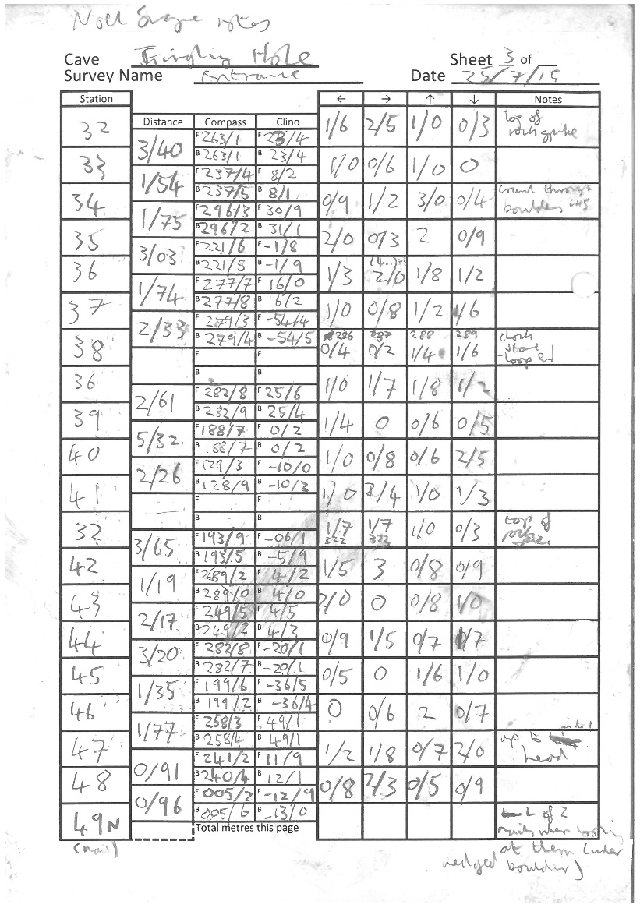
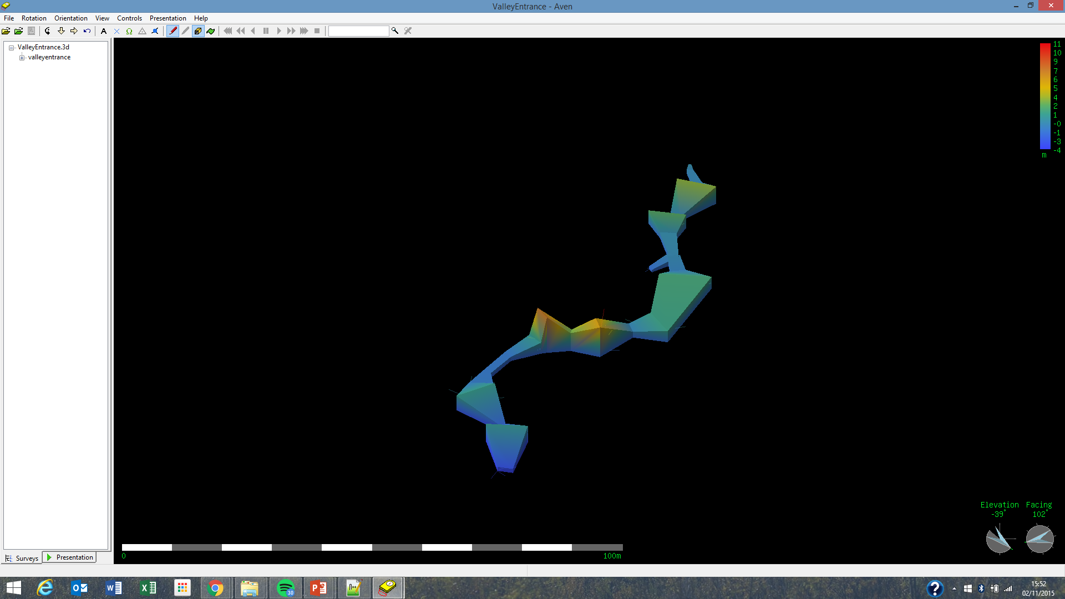
How to turn this…
Into this…

Slide 3
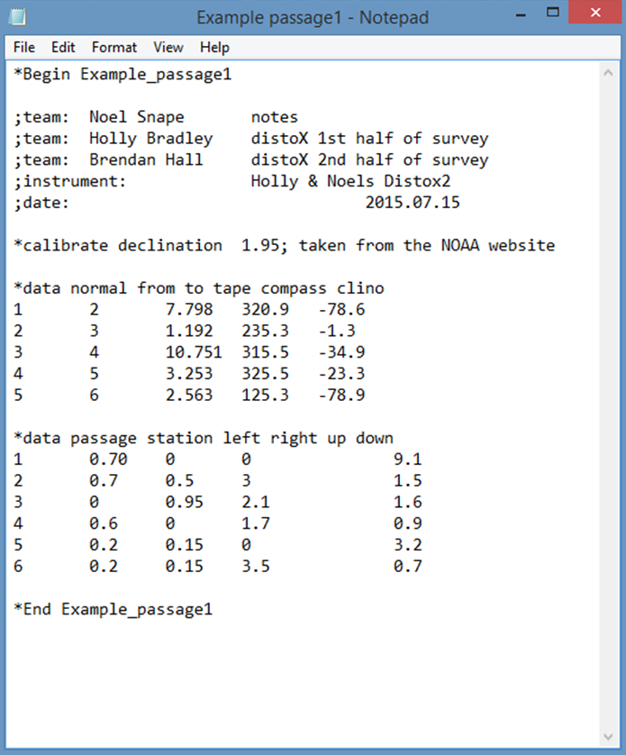
Step one: Open Notepad++
Begin By opening a text editor, this can be either
Notepad or Notepad++. Apparently you can use
Any text editor as long as it is capable of writing
A plain “ASCII text file”.
I’ve only managed to get survex to work with
notepad++

Slide 4
Step 2: Begin…
Insert Command “*begin (Insert name of cave passage)”.
The name of the cave passage should be unique and the same as
the survex file name & it will later be used to tie two separate
Survex files together.
In Survex the * symbol indicates the beginning of a command.
In a similar way, the semicolon symbol ; is used to indicate
the start of a comment, i.e. information which people may find
useful when looking at the survey data later but isn’t necessary in terms of creating a 3D file.
- information such as station descriptions.
- Team information (who was on book, who read compass ect.)
Important: the name of the file cannot contain a space, this leads to an error code when you come to process the file. Alternatively use an underscore _ instead.

Slide 5
Step 3: Add trip info
Add information about the surveying trip.
This information won’t be used by Survex to help create the 3D file, hence the line begins with a semicolon; instead of a star*.
I made a mistake in the manual here – the date is important for the 3D file as it allows users to see which passages have recently been surveyed with the software's “coulour by date option” if you ; comment it out it’ll just appear white. So add *date 15.07.2015 after “*begin” in the next step.
This data is important as it allows other parties to review the details of your trip and help them understand what has happened if issues arise in the future.
For example if we wanted to clarify where specific survey stations are in a survey we know who to go to to ask.

Slide 6
Step 4: Declination
The earths magnetic field varies slightly depending on: date and location, therefore to avoid error in our data it is important we take this into account.
Declination is the angle between magnetic north and true north, records can be found on various websites.
To find out what the declination was for your trip go to http://www.ngdc.noaa.gov/geomag-web/#declination.
The declination value should be around 1-2°, by convention a declination west of true north is +ve.
Don’t worry if you cba doing this, so long as you record the date and cave, someone else can work it out later.

Slide 7
Step 5: Centerline Data
Survex is pretty clever, you could input the stations in any order and as long as they all connect up, survex will still draw a 3D file for you.
The convention is to put the data into survey as shown in the example.
Tip: Use the Tab button instead of the space bar when inputting data, it’ll neatly arrange the data into columns making it easier to understand.
Note: see Survex manual for more ways of inputting centreline data.

Slide 8
Step 6: LRUD’s
In order to make the final 3D file appear 3D, you need to include passage dimensions.
The convention is to take readings of the distances to the: Left, Right, Up and Down of the station it relates to and to note them down in this order.
Note: for a normal passage LRUD’s are simple, however when a passage includes junctions/small side passages they become more complicated.
The next few slides explain how survex sees LRUD’s and how to take them properly

Slide 9
LRUD’s (Left and Right)
First of all, survex doesn’t necessarily insert LRUD’s the way you might imagine.
Plan View
1.Lets start with left and right
3. Therefore it is important to take this in to take this into account when taking LRUD’s in a cave, especially if the angles in the centreline get really big/small
2. When survex plots a left from a point, it’ll do it in the direction that bisects the angle centrelines attached to it.

Slide 10
LRUD’s (Up and Down)
The up’s and down’s in a survex file are plotted –90° +90° (clinometer reading) to each station. So imagine the cave passage is encased inside a bounding box, the Up’s and Downs point at the ceiling and at the floor
Elevation
However doesn’t work very well for pitches as the up readings are difficult to read/look flat in the final 3D file
This works perfectly for simple passages like this

Slide 11
Step 6: Station Descriptions
In order for other people to be able to easily pick up where you left off on a surveying trip it is important to keep a detailed record of where your survey stations are.
This is particularly important at the end of a surveying trip or at a junction.
To do this simply add a comment after the passage dimensions for a passage.

Slide 12
Step 7: *End
Similarly to *begin, you need to let survex know when you’ve finished inputting the data.
Enter “*End (the name of the survex file, same as the one at the start after *Begin)

Slide 13
Step 9: Create 3D file
To create a survex file do the following
Save as .svx (in this case Example passage1.svx)
Process the file by right clicking on the file and clicking process

Slide 14
Step 10: Process the 3D file
Finally right click on the file once it as been saved as .svx
Click on process
The file should automatically be processed into a 3D file and a log file
If something has gone wrong with the file, you will get an error file (ERR file). This is useful as it gives you an indication of what has gone wrong with your survex file
E.g. Passage1.svx:1:16: error: End of line not blank passage1.svx:28:14: error: End of line not blank This means that the 16th character of the 1st line & the 14th character of the 28th line has something wrong with it, in this case I left a space in the name of the passage.

Slide 15
Examples
There’s more than one way to make a survex file, I’ve attached some examples of some very different survex files which
all essentially do the same thing.
For more details about survex and how to do more fancy stuff either look at the survex manual (see Attached) or wait for the next instalment of Brendan’s surveying Tutorials.
These files will be a bit more complicated as they’re involved in a larger system of files (see next slide) and it seems people have different styles when it comes to making a survex file.
If you’re just starting out, it’s probably best to just find a template and stick to that.
This is a really simple introduction, I’ve probably missed out quite a lot but it’s probably enough to help you if your using survex or something.
https://drive.google.com/open?id=0B0zxkZdXB7vUMkU0emRLbm1QSTg

Slide 16
Next time… Cave Jigsaw
Each survey trip will have it’s own individual survex file associated with it.
These files are typed up in text format and can be processed, to give a 3D version of the file viewable in Survex’s
3D cave viewing software - Aven.
Survex files can be ‘stitched’ together to produce a larger 3D model comprising of several survex files tied together.
Survex files are tied together using a hierarchical system which I will go into in the next tutorial.
3D model
Of entire
Cave system/
Area
This Lesson focuses
On this level only.
Survex files
Organized into different files according to which cave they came from
Individual caves tied together - another text file is made instructing survex on which caves/stations to tie together
Individual survex files are tied together - another text file is created instructing Survex on which files/stations to tie together
Survex files
For individual
Surveying trips.

